Slide 1
ADBMS distributed Database
Disclaimer
The recipients of this content is advised not to circulate this content
Freely in the internet. This content is solely prepared for the acdemic purposes
Of students of AMITY University Kolkata. For any further usage, a written
Expression is required from the author.
Supriya Chakraborty
Assistant Professor (Senior Scale)
AMITY University, Kolkata supriya_k2@yahoo.com

Slide 2
What is Distributed Database ?
A distributed database (DDB) is an integrated collection of databases that is physically distributed across sites in a computer network.
A distributed database management system (DDBMS) is the software system that manages a distributed database such that the distribution aspects are transparent to the users.

Slide 3
Characteristics of Distributed Database
Location independent.
Distributed query processing.
Distributed transaction management.
Hardware independent.
Operating system independent.
Network independent.
Transaction transparency.
DBMS independent.

Slide 4
Advantages of Distributed database
Modular Development
More Reliable
Better Response
Lower Communication Cost
Notes:
Modular Development − If the system needs to be expanded to new locations or new units, in centralized database systems, the action requires substantial efforts and disruption in the existing functioning. However, in distributed databases, the work simply requires adding new computers and local data to the new site and finally connecting them to the distributed system, with no interruption in current functions.
More Reliable − In case of database failures, the total system of centralized databases comes to a halt. However, in distributed systems, when a component fails, the functioning of the system continues may be at a reduced performance. Hence DDBMS is more reliable.
Better Response − If data is distributed in an efficient manner, then user requests can be met from local data itself, thus providing faster response. On the other hand, in centralized systems, all queries have to pass through the central computer for processing, which increases the response time.
Lower Communication Cost − In distributed database systems, if data is located locally where it is mostly used, then the communication costs for data manipulation can be minimized. This is not feasible in centralized systems.

Slide 5
Factors encouraging for Distributed Database
Distributed Nature of Organizational Units
Need for Sharing Data
Support for both OLTP and OLAP
Database Recovery
Support for Multipole Application Software
Notes:
Distributed Nature of Organizational Units − Most organizations in the current times are subdivided into multiple units that are physically distributed over the globe. Each unit requires its own set of local data. Thus, the overall database of the organization becomes distributed.
Need for Sharing of Data − The multiple organizational units often need to communicate with each other and share their data and resources. This demands common databases or replicated databases that should be used in a synchronized manner.
Support for Both OLTP and OLAP − Online Transaction Processing (OLTP) and Online Analytical Processing (OLAP) work upon diversified systems which may have common data. Distributed database systems aid both these processing by providing synchronized data.
Database Recovery − One of the common techniques used in DDBMS is replication of data across different sites. Replication of data automatically helps in data recovery if database in any site is damaged. Users can access data from other sites while the damaged site is being reconstructed. Thus, database failure may become almost inconspicuous to users.
Support for Multiple Application Software − Most organizations use a variety of application software each with its specific database support. DDBMS provides a uniform functionality for using the same data among different platforms.

Slide 6
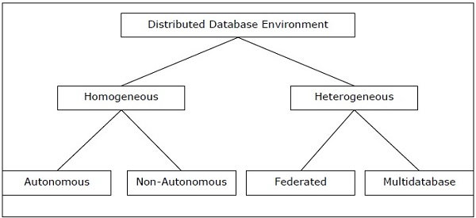
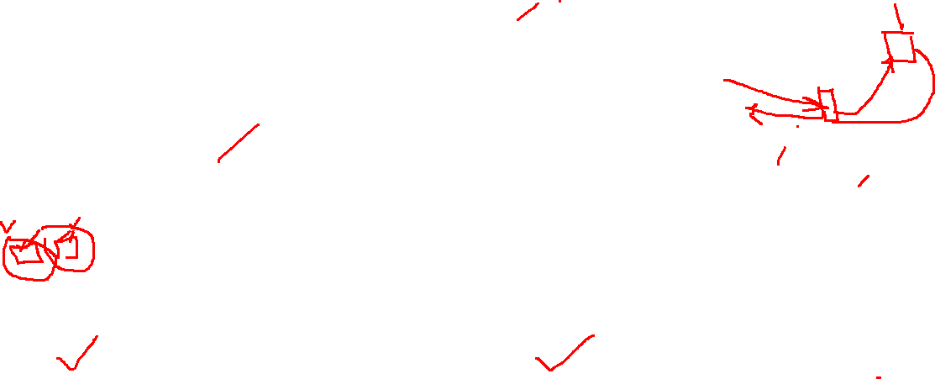
Types of Distributed Database
Notes:
Homogeneous Distributed Databases
In a homogeneous distributed database, all the sites use identical DBMS and operating systems. Its properties are −
The sites use very similar software.
The sites use identical DBMS or DBMS from the same vendor.
Each site is aware of all other sites and cooperates with other sites to process user requests.
The database is accessed through a single interface as if it is a single database.
Types of Homogeneous Distributed Database
There are two types of homogeneous distributed database −
Autonomous − Each database is independent that functions on its own. They are integrated by a controlling application and use message passing to share data updates.
Non-autonomous − Data is distributed across the homogeneous nodes and a central or master DBMS co-ordinates data updates across the sites.
Heterogeneous Distributed Databases
In a heterogeneous distributed database, different sites have different operating systems, DBMS products and data models. Its properties are −
Different sites use dissimilar schemas and software.
The system may be composed of a variety of DBMSs like relational, network, hierarchical or object oriented.
Query processing is complex due to dissimilar schemas.
Transaction processing is complex due to dissimilar software.
A site may not be aware of other sites and so there is limited co-operation in processing user requests.
Types of Heterogeneous Distributed Databases
Federated − The heterogeneous database systems are independent in nature and integrated together so that they function as a single database system.
Un-federated − The database systems employ a central coordinating module through which the databases are accessed.

Slide 7

Architecture of DDBMS
Client-server
ANSI SPARK Architecture

Slide 8
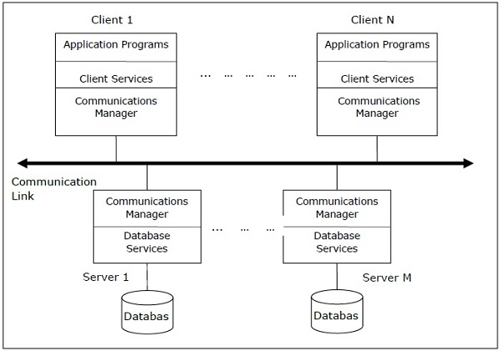

Client-server architecture
Notes:
This is a two-level architecture where the functionality is divided into servers and clients. The server functions primarily encompass data management, query processing, optimization and transaction management. Client functions include mainly user interface. However, they have some functions like consistency checking and transaction management.
The two different client - server architecture are −
Single Server Multiple Client
Multiple Server Multiple Client (shown in the following diagram)

Slide 9
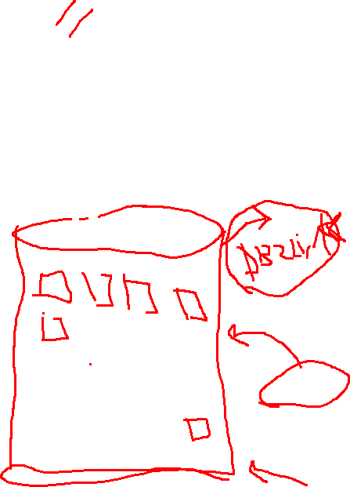
Fragmentation
Fragment is the sub-set of Relation
Types of Fragments
Horizontal Fragments
Vertical Fragments
Hybrid Fragments

Slide 10

Horizontal Fragments
Consider the relation Emp:
Fragment 1
Fragment 2

Slide 11
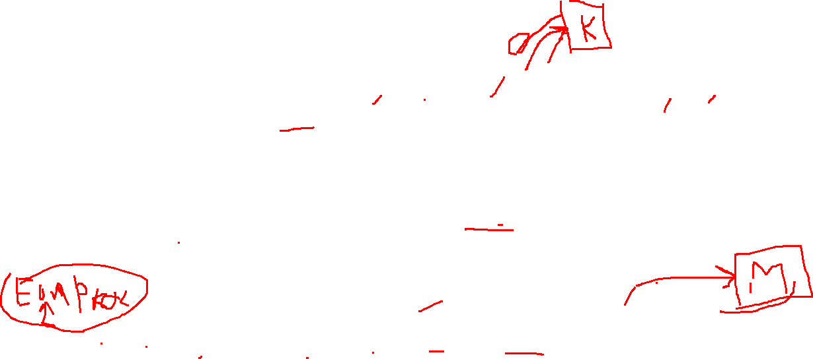
How Horizontal Fragment is formed?
Consider schema EMP (eno, name, city, skill, sal, comm) and the organization has few branches in every metropolitan city of India.
Fragments are created using PREDICATE that exactly suits the need
Π_{eno,name,city, skoll, sal,comm} (σ_{city=‘Kolkata’} (EMP))
Π_{eno,name,city, skoll, sal,comm} (σ_{city=‘Mumbai’} (EMP))
Π_{eno,name,city, skoll, sal,comm} (σ_{city=‘Delhi’} (EMP))

Slide 12
Notation
Suffix is used to represent the fragment
EMP is compartmentalize into EMP_{kolkata} and EMP_{mumbai} and EMP_{delhi}

Slide 13

Vertical Fragments
ENO | Name | Add | Skill | Sal | Comm
EMP_{skill}<- Π_{eno,name,Add, skill} (σ_{city=‘Kolkata’} (EMP)) – Hybrid / Mixed Fragment
EMP_{skill_Kol}<- Π_{eno,name,Add, skill} (EMP_{kol})
EMP_{finance_Kol} <- Π_{eno,name, Sal, comm} (EMP_{kol})

Slide 14
Problem 1
Suppose three sales units works homogeneous autonyms decision making policy ( Distributed). However, all these three units under the centralized control of another unit.
Whether all four together is distributed or not?
Answer: A distributed system under centralized system is also a centralized system.

Slide 15
Problem 2
Scenario: Consider the determination of horizontal fragments for a global relation EMP. Assume that the important applications of this distributed database require information from relation EMP about employees who are members of projects. Let each department be a site of the distributed database.
Applications can be issued at any department; however, when they are issued at a given department, they reference the tuples of employees of that department with higher probability than the tuples of other employees. This happens because existing employees are distributed in departments, because each project is made in one department, and because information about projects is typically requested by employees who work in the project. Then, in this simple case, fragments are designed by collecting in each fragment the tuples of employees who work at the same department; these tuples have the same properties from the viewpoint of their allocation.
Find the predicate for fragmentation: Consider above scenario on horizontal fragmentation. Assume that some important applications require, information about employees who are members of projects; assume that there are also other important applications which require only the data of employees who are programmers; these last applications can be issued at any site of the distributed database,and reference all programmers with the same probability. Let us assume for simplicity that there are only two departments, 1 and 2; thus, DEPT = 1 is equivalent to DEPT =^ 2, and vice versa.
Notes:
Abhimanyu – department job role: programmer
Ankit : Hybrid fragmentation -> attribute: job, Details (D)
Inconsistent -> incorrect
P1 : Dept= 1 and job = P
p2 : Dept != 1 and job =p
P3: Dept = 1 and job != p
P4: Dept != 1 and Job != p
P5= Dept= 2 and job = p

Slide 16
Predicates
Simple Predicate – Where one attribute is used. P = p where p is a predicate.
Minterm predicate – More than one attributes exist P = V p_{i}
A predicate must be relevant. P has at least more than one simple predicate and each expression produce the different results.

Slide 17
Rules for creating fragment
Complete Rule – There should not be any record/tuplpe in global relation that is not mapped into any fragment.
Reconstruction : R =R₁ U R₂ UR₃ U…… UR_{n}
Disjointness: Each record must ne be mapped one and only one relation.
If rules of forming fragments are not maintained, then there is a chance of inconsistent Distributed
Database.

Slide 18

Replication
Replication is a technique used in distributed databases to store multiple copies of a data table at different sites.
EMP
EMP
EMP

Slide 19
Advantages of Replication
Increase Reliability
Increase Availability
Quick Access or low network cost
Notes:
Centralized System principally reduce redundancy to maintain the consistency of the data whereas DDBMS forces replication to increase reliability and availability.
Reliability implies the amount of times that system performs according to specification within the predefined duration of time.
Availability of the system implies the amount of time the system is available within predefines duration of time.
Reliability is measured by Mean-time-to-failure (MTTF) whereas availability is Mean time to Repair (MTTR)
The cost of the product greatly influence on there two metrics.

Slide 20

Demerits of replication
Over replication introduces the overhead time to maintain the consistency specially in udate operation.
Over replication also increase complexity of the system to perform many operations, 3-Phase-COMMIT.

Slide 21
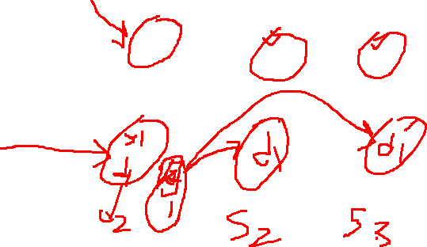
Replication Control Techniques
Synchronous Update
Asynchronous Update
Notes:
In synchronous replication approach, the database is synchronized so that all the replications always have the same value. A transaction requesting a data item will have access to the same value in all the sites. To ensure this uniformity, a transaction that updates a data item is expanded so that it makes the update in all the copies of the data item. Generally, Three / two-phase commit protocol is used for the purpose.
In asynchronous replication approach, the replicas do not always maintain the same value. One or more replicas may store an outdated value, and a transaction can see the different values. The process of bringing all the replicas to the current value is called synchronization.
Asynchronous Update : With each record / tuple, a dirty bit is associated ( bydefault value is 0). While the record gets update, the dirty bit is set (1). DDBMS in low load time, checks the dirty bit, and send the request to the concerned site to update the data.

Slide 22
Replication and Allocation
S1
R
R₁¹
R₁
R₂
R₃
R₂²
R₃²
S2
S3
R₁³
Notes:
Suffix is used to represent the fragments.
On which basis we allocate the fragment into the site?

Slide 23
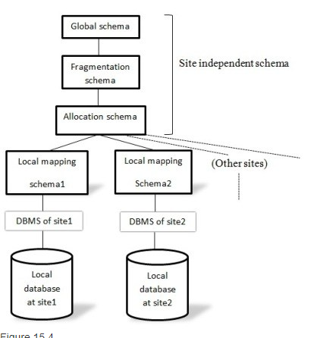
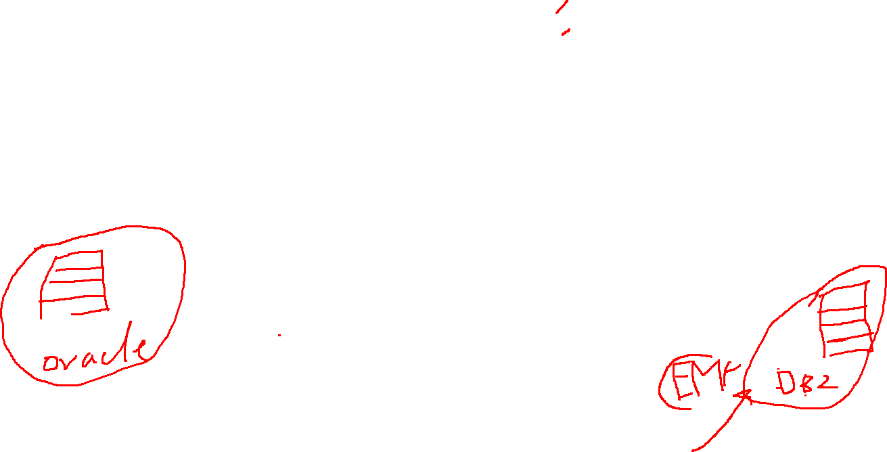
Reference architecture of DDBMS
Notes:
Global Schema : EMP ( eno, name, add, sal, comm, skill, degree) . The advantage of the global schema is to reduce the naming anomalies.
Fragment Schema : EMP -> EMP₁, EMP₂, EMP₃
Allocation Schema : EMP₁², EMP₂³, EMP₃¹
Site independence also implies that in every site ( the site of oracle or site of DB2), these three modules remains on top of the RDBMS/DBMS.
Local Mapping Schema : It integrates the site independent layers to the database of the site.
It transforms the lexigraphy.
It transforms all the instrunction which are relevant to the site e.g., you use ISNULL in oracle database, however data is actually in DB2 site, the local mapping schema will take the necessary actions.

Slide 24
Tutorial – Fragmentation
Consider the distributed database for a company in California having three sites at San Francisco (site 1), Fresno (site 2), and Los Angeles (site 3); Fresno is located about halfway between San Francisco and Los Angeles. There are 30 departments, physically grouped as follows:
the first 10 are close to San Francisco,
departments between 11 and 20 are close to Fresno, and
departments over 20 are close to Los Angeles.
Suppliers of the company are all either in the city of San Francisco or in the city of Los Angeles; there is also the notion of areas into which the company is divided; the area "North" includes San Francisco, the area "South" includes Los Angeles, and Fresno falls exactly on the border, with some departments close to Fresno in the northern area and some in the southern.
The global schema is that of EXAMPLE_DDB including relations EMP, DEPT, SUPPLIER, and SUPPLY.

Slide 25

We design the fragmentation of SUPPLIER and DEPT with a primary fragmentation.
We start by analyzing the relation SUPPLIER{SNUM,NAME,CITY). City assumes just two values, "SF" and "LA"; SUPPLIERS in "SF" or "LA" are about the same in number. Let us assume that there is just one important application : requiring the NAME of suppliers with a given number SNUM. A SQL query for this application is:
Select NAME
from SUPPLIER
where SNUM = $X

Slide 26
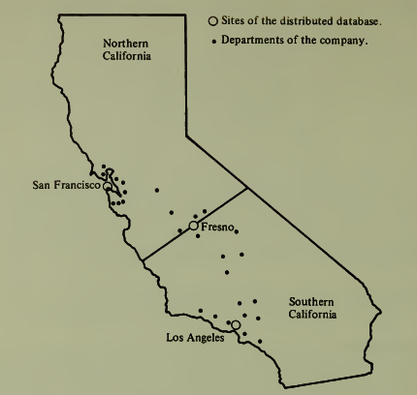
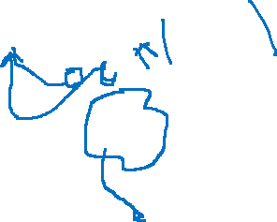

This application is issued at any one of the sites; if it is issued at site 1, it references
SUPPLIERS whose CITY is "SF" with 80 percent probability; if it is issued at
site 2, it references SUPPLIERS of "SF" and "LA" with equal probability; if it is
issued at site 3, it references SUPPLIERS of "LA" with 80 percent probability. This
comes from the fact that departments around one city tend to use suppliers which
are close to them.

Slide 27

We can apply to this simple case the method for producing the predicates:
• p1 : CITY= "SF"
• p2 :CITY= "LA"
Since the set { p1 , P2 } is complete and minimal, the search is terminated. Though simple, this example shows two important features: The predicates which are relevant for describing this fragmentation cannot be deduced by analyzing the code of an application; in our example, the values of CITY generate the predicates, and there is no reference to them in the query. Implications between predicates reduce the number of fragments. In this case, we should consider as fragments those which correspond to the following minterm predicates:
Y1 : {CITY = "SF") AND ( CITY = "LA")
Y2: {CITY= "SF")AND NOT {CITY= "LA")
Y3: NOT ( CITY= "SF") AND ( CITY= "LA")
Y4: NOT ( CITY = "SF")AND NOT (CITY= "LA“)
but we know that:
(CITY= "LA”) implies not (CITY= "SF“)
( CITY= "SF“) implies NOT{CITY = "LA“)
and therefore we can infer that y1 and y4 are contradictions, and y2 and y3 reduce to the two predicates p1 and p2 .

Slide 28


Let us consider now the global relation: DEPT(DEPTNUM, NAME, AREA, MGRNUM)
We concentrate on the following important applications:
1. Administrative applications, which are issued only at sites 1 and 3; administrative applications about departments in the northern area are issued at site 1;
those about departments in the southern area are issued at site 3.
2. Applications about work conducted at each department; they can be issued at any department, but they reference tuples of the departments which are
closer to their site of origin with higher probability than the tuples of other departments.
By applying the same method, we produce the following set of predicates:
P1: DEPTNUM < 10
P2 : 10 < DEPTNUM < 20
P3 : DEPTNUM > 20
P4: AREA = "North"
P5:AREA = "South"
There are a number of implications between them (for instance, AREA = "North“ implies that DEPTNUM > 20 is false); thus, the fragmentation that they introduce reduces to four fragments:
Vl : DEPTNUM < 10
y2: (10 < DEPTNUM < 20) AND (AREA
y3 : (10 < DEPTNUM < 20) AND (AREA
y4 : DEPTNUM > 20

Slide 29
 | p4: AREA = "North" | p5: AREA = "South"
P1:DEPTNUM < 10 | y1 | False
P2: 10 < DEPTNUM < 20 | y2 | y3
P3: DEPTNUM > 20 | False | y4

Slide 30
Board Work
Data is fragmented based horizontal / vertical / mix that is based on application.
How to allocate the fragment? In which site, fragments are plased?

Slide 31
Allocation of Fragments and replication

Slide 32
General Criteria for allocation
Non-redundant allocation – Best Fit
Or
Redundant Allocation –
Introduces additional problems:
1. The degree of replication of each fragment becomes a variable of the problem.
2. Modeling read applications is complicated by the fact that the applications can now select among several alternative sites for accessing fragments.
Notes:
In determining the allocation of fragments, it is important to distinguish whether we design a final nonredundant or redundant allocation.
Determining a nonredundant final allocation is easier. The simplest method is a "best-fit" approach; a measure is associated with each possible allocation, and
the site with the best measure is selected. This approach gives a solution which disregards the "mutual" effect of placing a fragment at a given site if a related
fragment is also at that site.
Replication introduces further complexity in the design, because:
1. The degree of replication of each fragment becomes a variable of the problem.
2. Modeling read applications is complicated by the fact that the applications
can now select among several alternative sites for accessing fragments.

Slide 33
Two Approaches for redundant allocation of fragment
1. Determine the set of all sites where the benefit of allocating one copy of the fragment is higher than the cost, and allocate a copy of the fragment to each element of this set; this method selects "all beneficial sites."
2. Determine first the solution of the nonreplicated problem, and then progressively introduce replicated copies starting from the most beneficial; the process is terminated when no "additional replication" is beneficial.

Slide 34
Measure the cost and benefit of allocation
Best Fit
All Beneficial site
Additional Replication

Slide 35

Definition
i is the fragment index
J is the site index
K is the application index
f_{kj} is the number of frequency of application k at site j
R_{ki} is the number of retrieval references of application k to fragment i
U_{ki} is the number of update references of application k to fragment i
n_{ki}= R_{ki} - u_{ki}

Slide 36
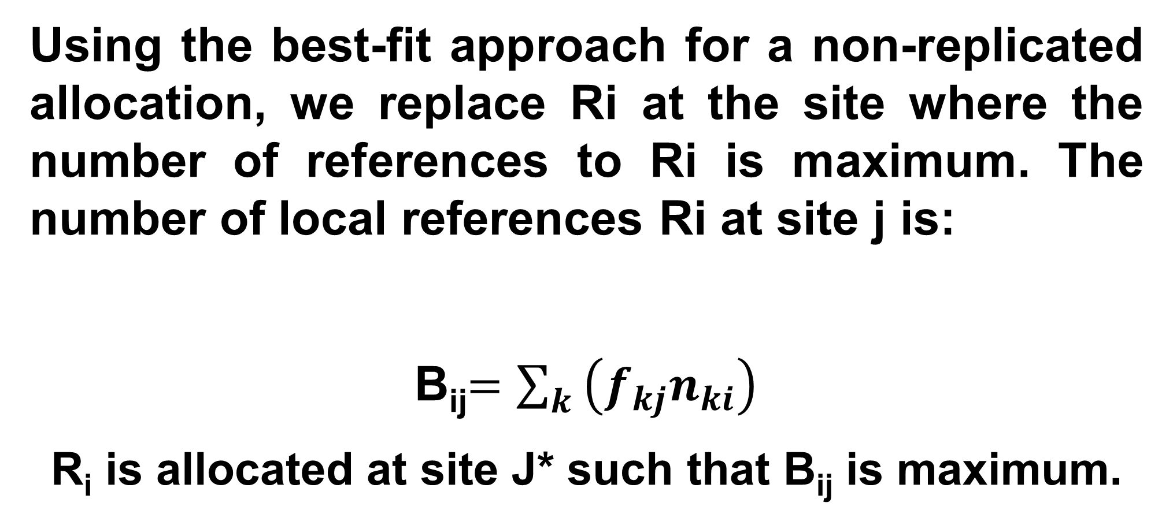
Best-Fit
Using the best-fit approach for a non-replicated allocation, we replace Ri at the site where the number of references to Ri is maximum. The number of local references Ri at site j is:
B_{ij}$=\sum_{k}{\left(f_{kj}n_{ki}\right)}$
R_{i} is allocated at site J* such that B_{ij} is maximum.

Slide 37
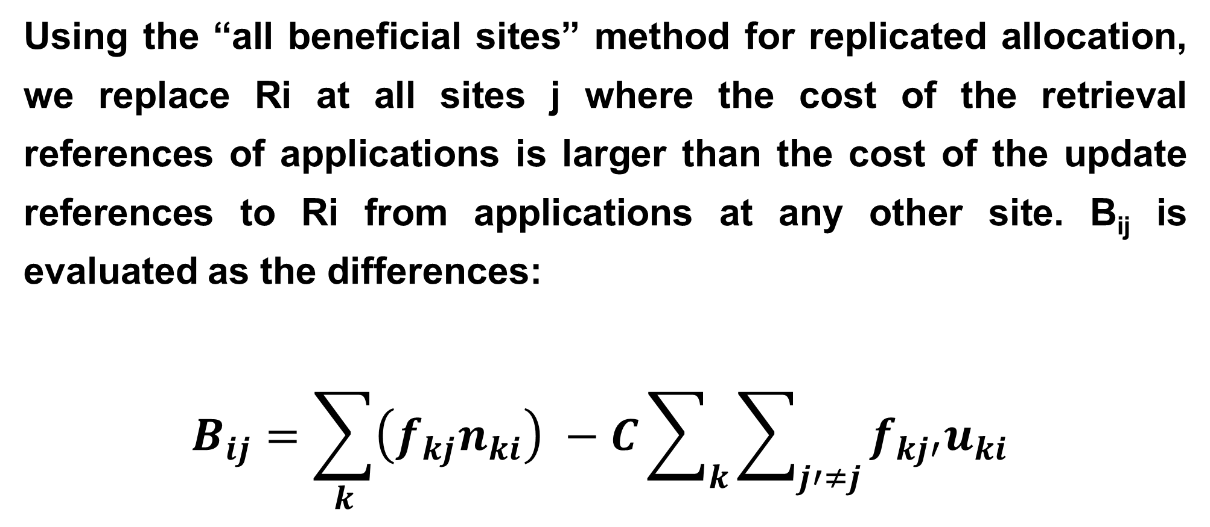
All Beneficial site
Using the “all beneficial sites” method for replicated allocation, we replace Ri at all sites j where the cost of the retrieval references of applications is larger than the cost of the update references to Ri from applications at any other site. B_{ij} is evaluated as the differences:
$$B_{ij}=\sum_{k}{\left(f_{kj}n_{ki}\right) −C\sum_{k}{\sum_{j′≠j}{f_{kj′}u_{ki}}} }$$

Slide 38
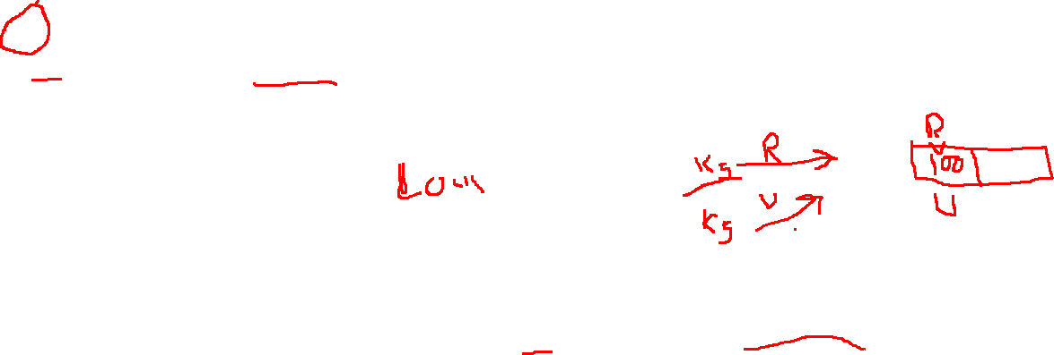
C is a constant which measures the ratio between the cost of an update and a retrieval access; typically, update accesses are more expensive, since they require a larger number of control messages and local operations (thus,C > 1).
Ri is allocated at all sites j* such that Bij is positive; when all Bij are negative, a single copy of Ri is placed at the site such that Bij is maximum.

Slide 39
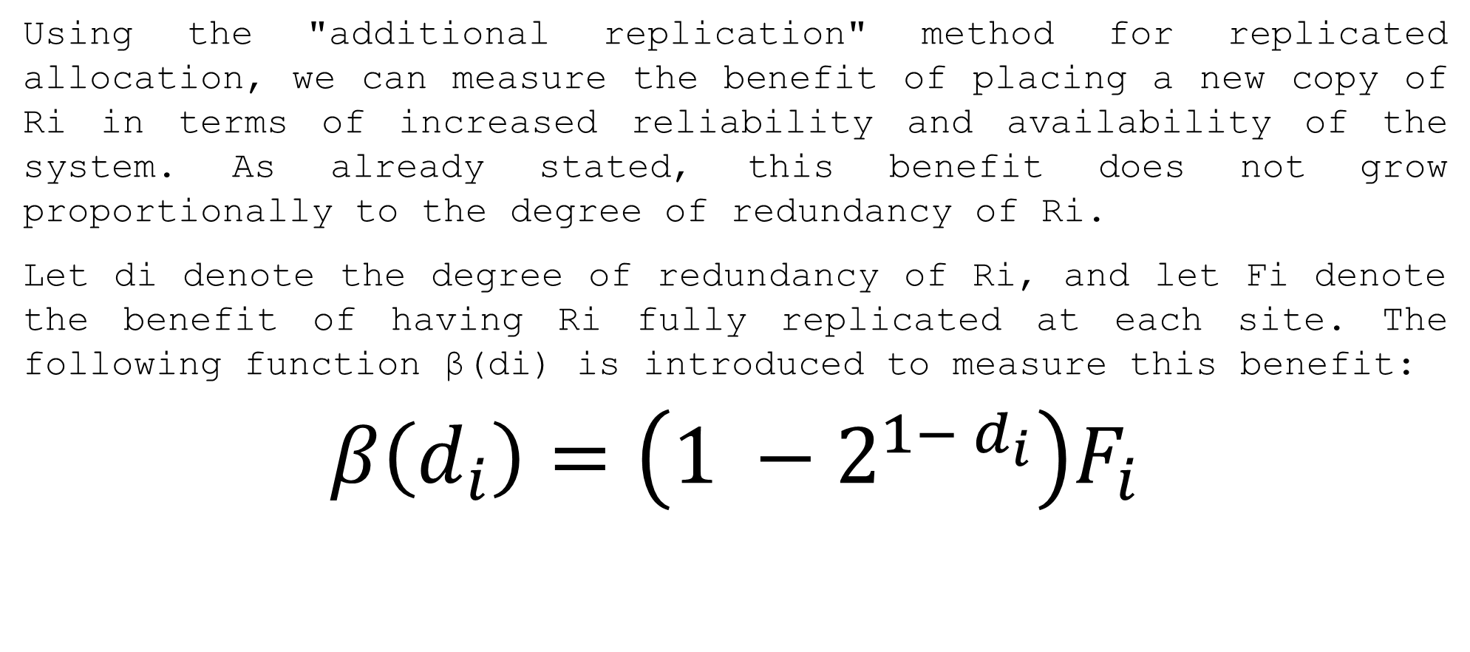
Additional Replication
Using the "additional replication" method for replicated allocation, we can measure the benefit of placing a new copy of Ri in terms of increased reliability and availability of the system. As already stated, this benefit does not grow proportionally to the degree of redundancy of Ri.
Let di denote the degree of redundancy of Ri, and let Fi denote the benefit of having Ri fully replicated at each site. The following function β(di) is introduced to measure this benefit:
$$β\left(d_{i}\right)=\left(1 −2^{1− d_{i}}\right)F_{i}$$

Slide 40
Demerits of All Beneficial algo.
The degree of replication – If the number of sites are n, and in each site the benefit Bij gets positive, then in all the sites, the fragment Ri is replicated.
The benefit of each replication varies, in this case the replication is not controlled.

Slide 41

Note that β(1) = 0, β(2) = Fi /2, β(3) = 3Fi/4, and so on. Then, we evaluate the benefit of introducing a new copy of Ri at site j by modifying the previous formula:
$$B_{ij}=\sum_{k}{\left(f_{kj}r_{ki}\right) −C\sum_{k}{\sum_{j^{′}≠j}{f_{kj^{′}}u_{ki}+}}β(d_{i}) }$$

Slide 42

Update and movement of record into another fragment
Eno | Name | City
E1 | Abu | Mum
E2 | Raban | mum
E3
Omrish
E3
Kol
Omrish
Mum
EMP (eno,name, city) creates two fragments
EMP_{Kol}(eno,name, city) and EMP_{Mum}(eno,name, city)
Update Emp set city=‘kol’ where eno=‘E3’
Eno | Name | City
E4 | Pheluda | Kol
E5 | Kakababu | Kol

Slide 43
All Beneficial sites
The set of all sites where the benefit of allocation one copy of the fragment is higher than the cost, and allocate a copy of the fragment to each element of this site.

Slide 44
Additional Replication
First the solution of the non-replicated problem, and then progressively introduce replicated copies starting from the most beneficial; the process is terminated when no additional replication is beneficial.

Slide 45
Book
Distributed Databases Design and Principles; Stefano Ceri and Giuseppe Pelagatti; TMgH
Principles of Distributed Database Systems; M. Tamer Ozsu and Patrick Valduriez; Springer
Invitation from the Author
The reader of this content is invited to upgrade this presentation for increasing the
Understanding. Any new problem with solution will be highly entertained.

